Slide 1
Title:
Bird recognition &
Prevention system
Faculty Guide: Abhay Upadhyay
Enroll No. | Name
160280111032 | KACHHADIYA JEMIN
160280111043 | MANSURI ADIL
160280111050 | PANDYA HET

Slide 2
ABSTRACT:
The electronic system designed using Fast Image processing and arduino, servo etc which can help to repel the birds away from Engine fan of aircrafts, farms for protect crops from damages caused by birds, commercial wind mills, exhaust fans, etc.

Slide 3
REASON:
In today’s time, as the increment in day to day technology we forget to see the safety of the other living beings.
We observe that so many birds are being killed while striking the wings and engine of the aircrafts.
In farms, the crops are being damaged by the birds.
Sometimes in the halls, the shield remains absent in the exhaust fan so that many birds strikes them and being killed.
The same thing happens in the wind mills at windfarms near seashore.

Slide 4
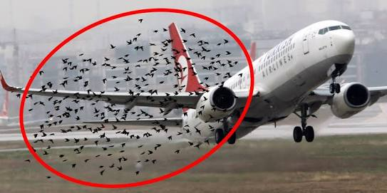
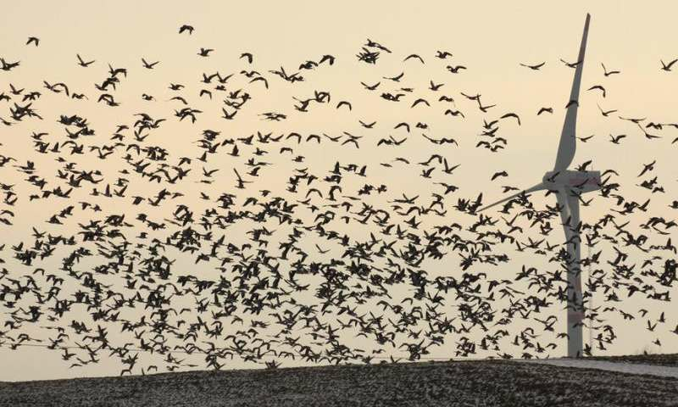
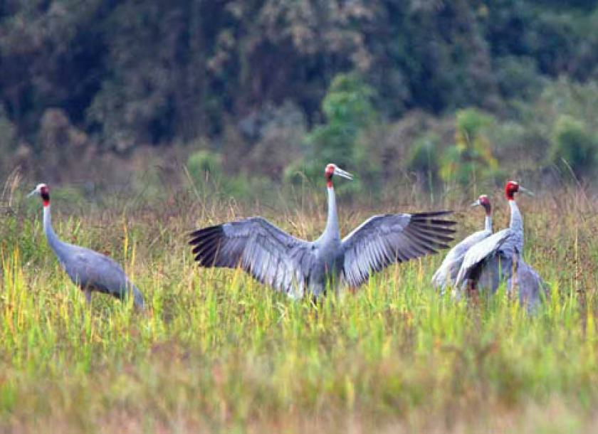

Slide 5
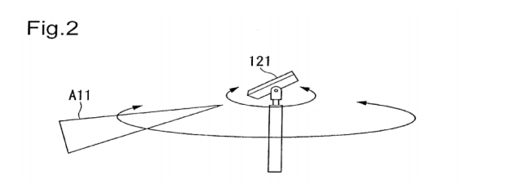
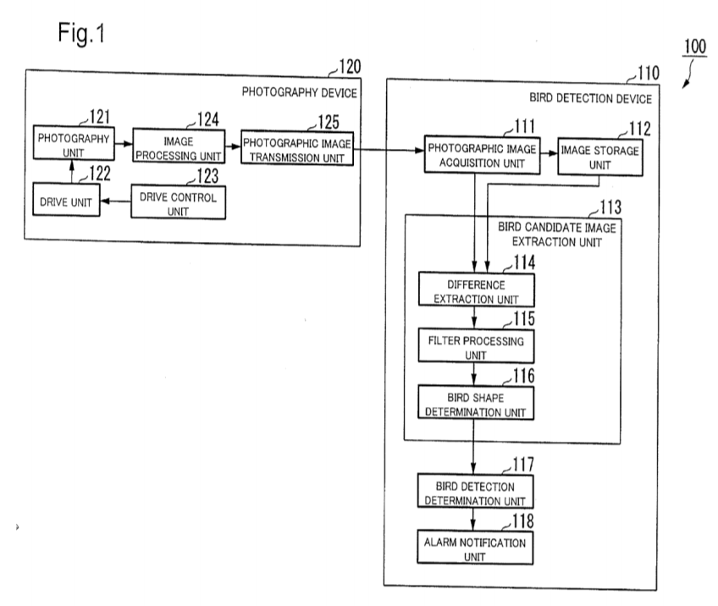
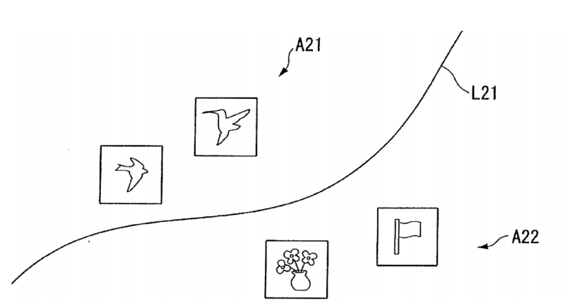
How can we solve this problem?
Rotor with detecting camera
Block diagram of detection method
By this way only birds will be detected

Slide 6
HARDWARE REQUIRED:
ARDUINO UNO
SERVO MOTOR
CAMERA
COMPUTER SYSTEM
LASER DIODES
DC POWER SOURCE
SOFTWARE:
ARDUINO COMPILER
PYTHON INTERPRETER
OPENCV LIBRARY
NUMPY, PYSERAIL
CAFFE LIBRARY
CAFFEMODEL_73000_INTERATION

Slide 7
WORK DONE:
We have visited the location such as airport, farms, wind mill station, seen few halls where actually seen the live striking of the birds and being killed at windmill.
Worked on simulating software tool python and try to detect exact location of bird and path to look for another simulating software arduino supporting our requirements and emit laser at the bird location.
We design the system(how efficient it can be according to its dimensions).

Slide 8
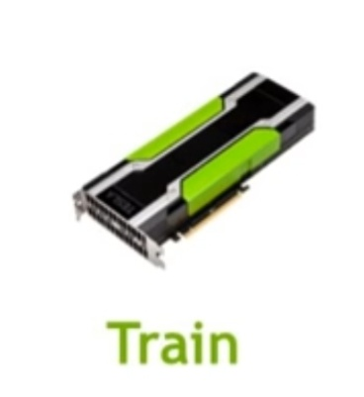
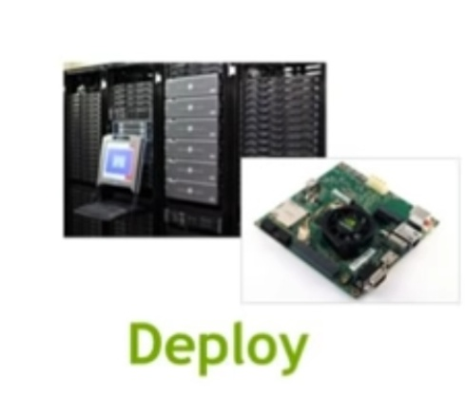
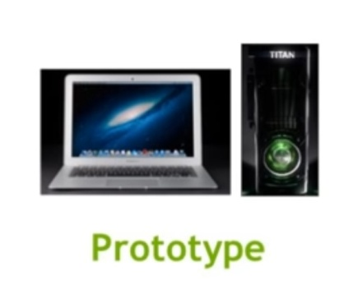
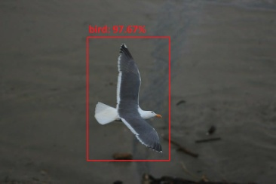
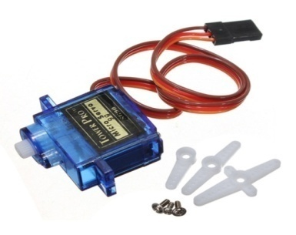
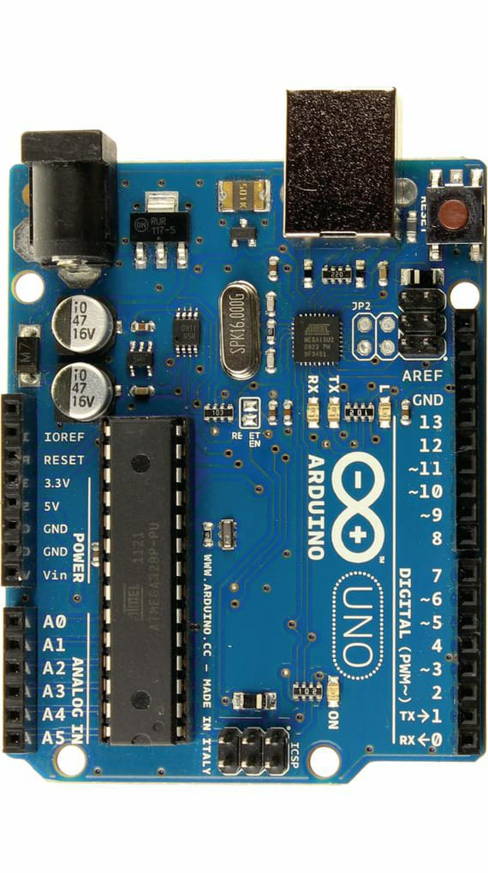
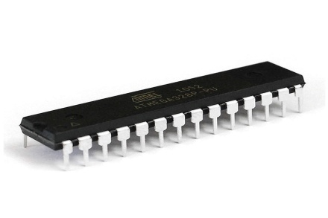
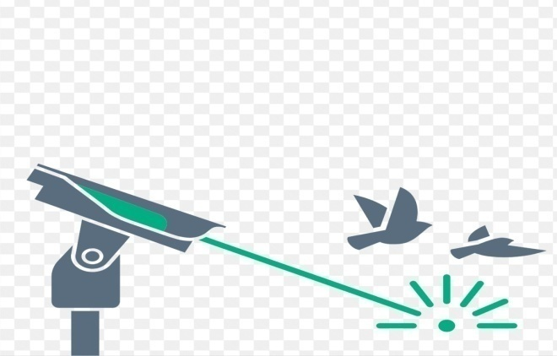
Processing
Image

Slide 9
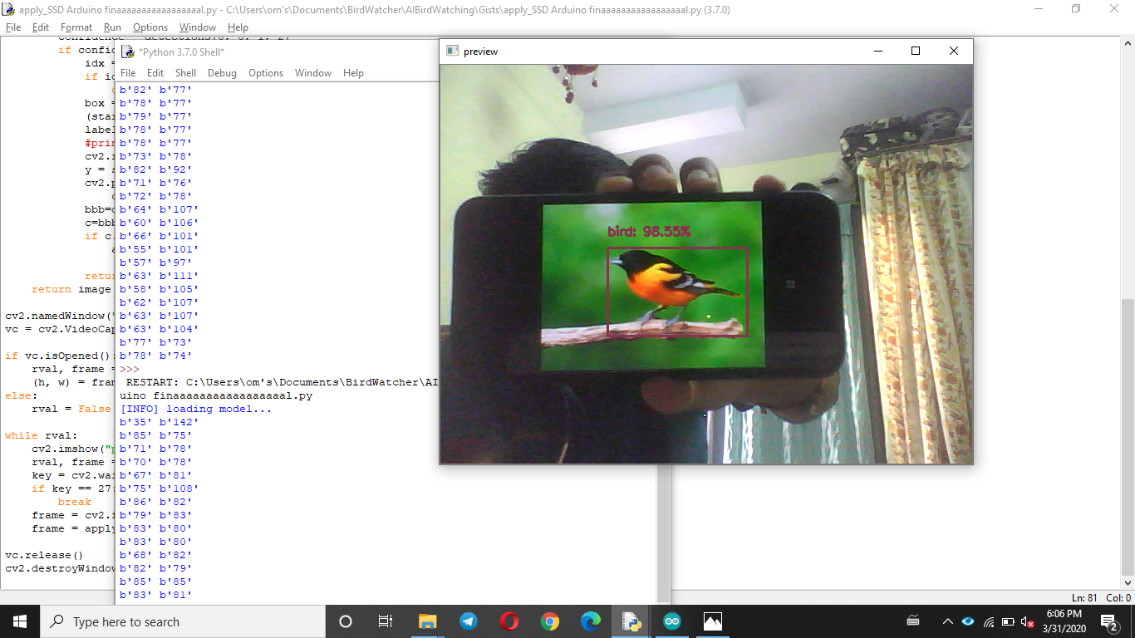

Slide 10
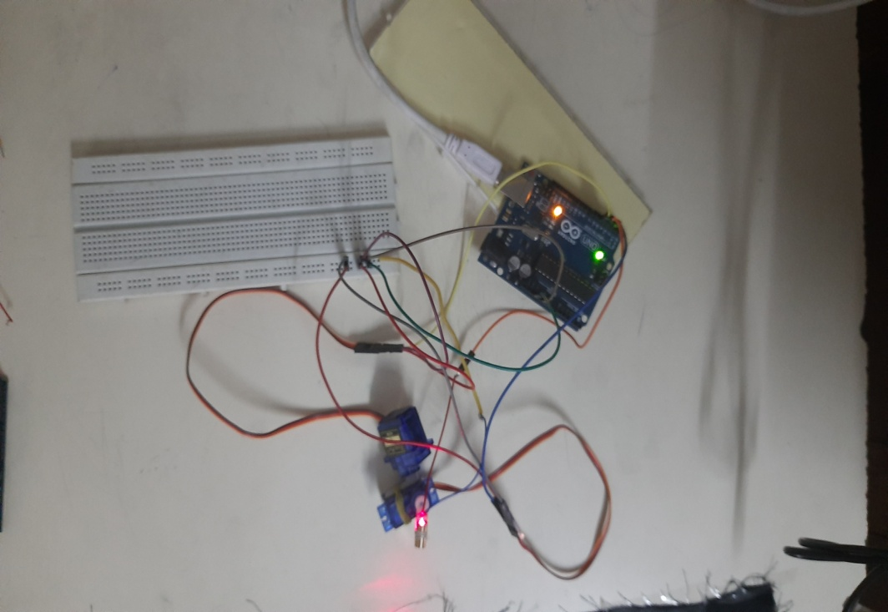
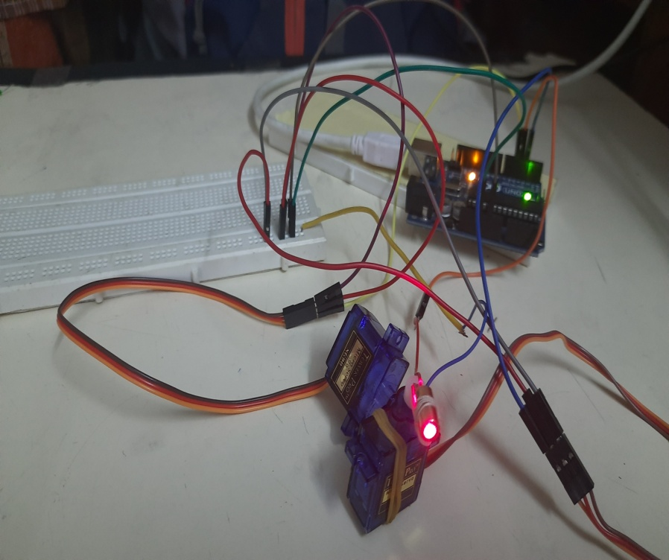
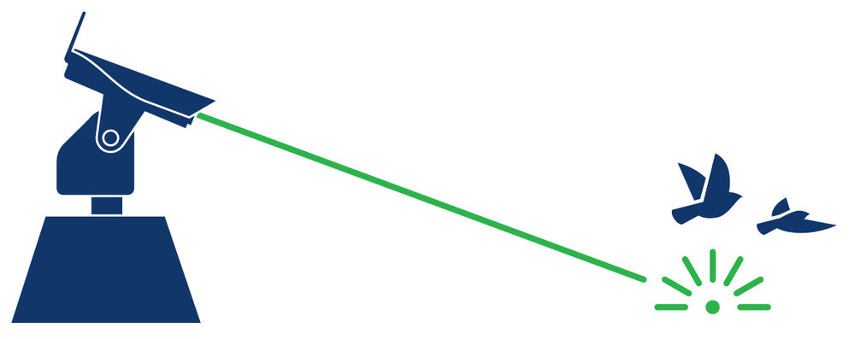

Slide 11
Why caffe?
Expressive architecture encourages application and innovation. Models and optimization are defined by configuration without hard-coding. Switch between CPU and GPU by setting a single flag to train on a GPU machine then deploy to commodity clusters or mobile devices.
Extensible code fosters active development. In Caffe’s first year, it has been forked by over 1,000 developers and had many significant changes contributed back. Works on CNN Architecture for convolution neural network applied in both code and models.
Speed makes Caffe perfect for research experiments and industry deployment. Caffe can process over 60M images per day with a single NVIDIA K40 GPU*. That’s 1 ms/image for inference and 4 ms/image for learning and more recent library versions and hardware are faster still. We believe that Caffe is among the fastest convnet implementations available.
Community: Caffe already powers academic research projects, startup prototypes, and even large-scale industrial applications in vision, speech, and multimedia. Join our community of brewers on the caffe-users group and Github.

Slide 12

CNN architecture it can be used in image classification.

Slide 13
START
Flowchart for Python
Flowchart for python code
VIDEO CAPTURE
CAFFE MODEL AS TRAINED MODEL
EXTRACT DATA
IMAGE PROCESSING
SET PREDICTION
DISPLAY BIRD DETECTED
END
LOCATE BIRD POSITION
CONVERT INTO BITCODE
SEND DATA TO ARDUINO
END

Slide 14
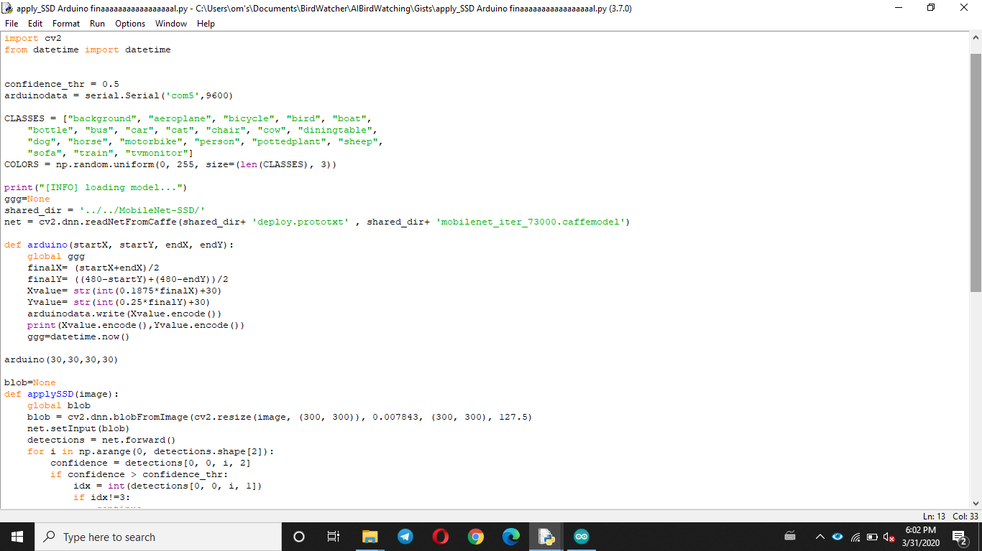
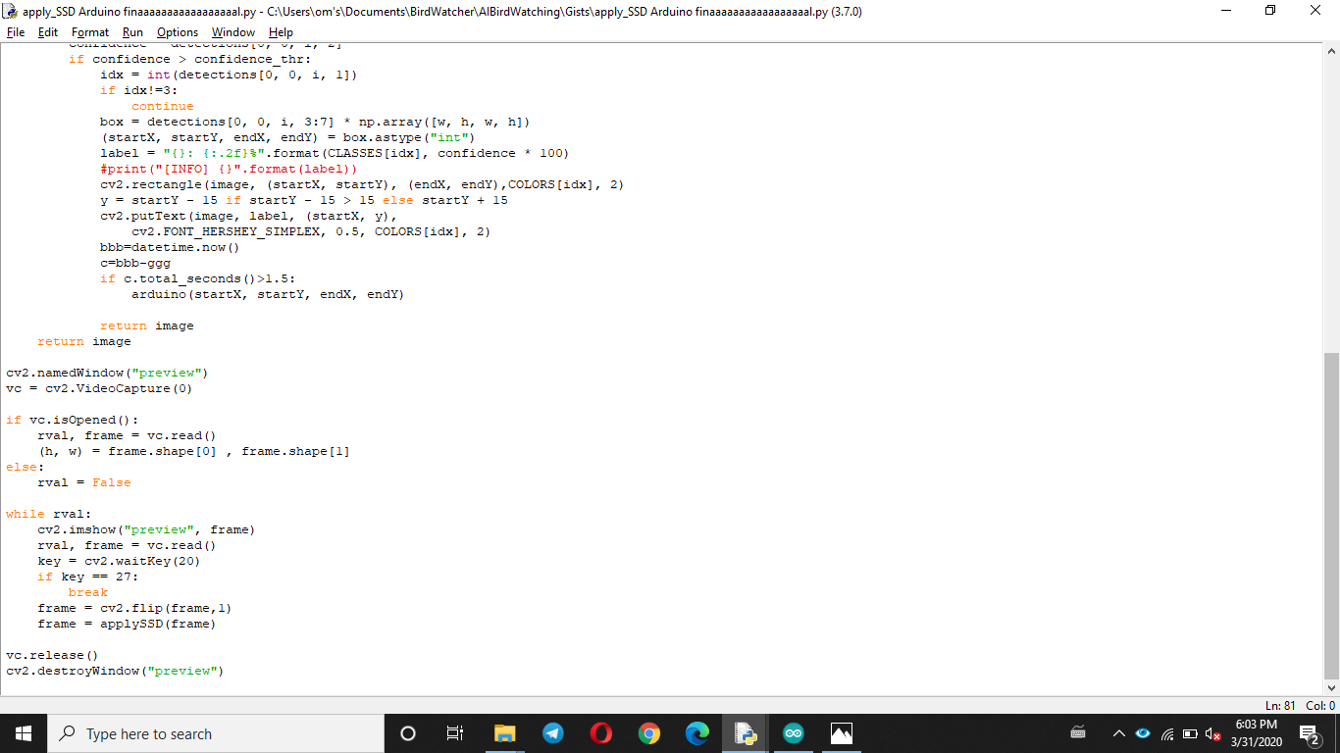
Code for bird detection in python

Slide 15
Flowchart for Arduino
START
RESULT
GET DATA FROM PYTHON
STOP
ENCODE TO STRING
GIVE COMMAND TO SERVO
FOR LASER SET COUNTER

Slide 16
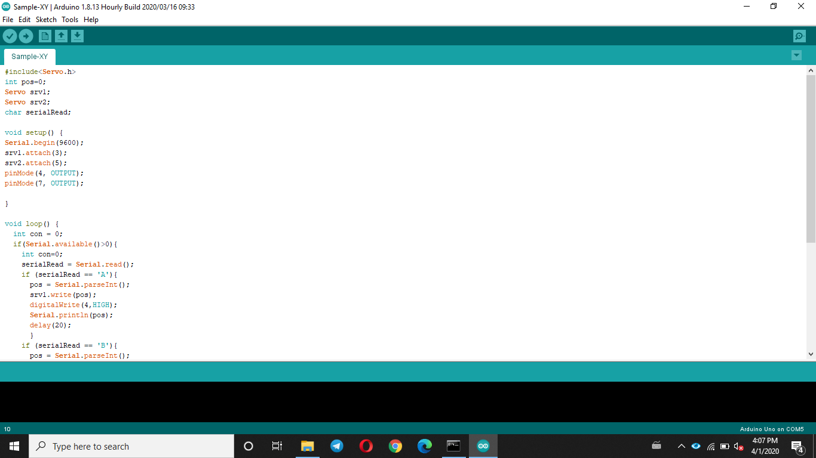
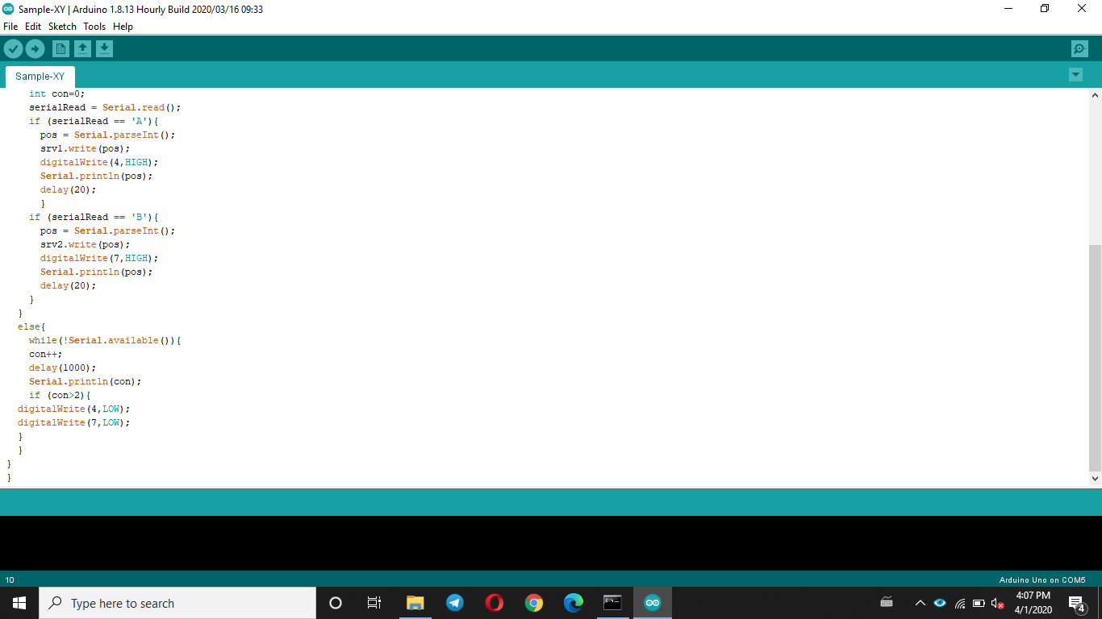
Arduino code for controlling servo and laser

Slide 17
Functions used in python for bird detection
net = cv2.dnn.readNetFromCaffe(args["prototxt"], args["model"])
Here we get model and prototxt file from caffe library and process the captured frame through this model with the use of deep neural network.
blob = cv2.dnn.blobFromImage(cv2.resize(image, (300, 300)), 0.007843,(300, 300), 127.5)
This blob function converts this image into huge blob (binary codes) with the use of different parameters in the function as an attribute.

Slide 18
net.setInput(blob)
detections = net.forward()
Here we set blob as an input of net which is main parameter for specific image detection. And forward function is the for getting data from the deploy model via detection [0, 0, i, 1:7]
box = detections[0, 0, i, 3:7] * np.array([w, h, w, h])
Detection get data about i=classes and 3:7 = matrix contain location info about bird in frame and np.array will create an array form for start(X,Y) and end(X,Y) .
cv2.rectangle(image, (startX, startY), (endX, endY),COLORS[idx], 2)
It will create a rectangle on frame where object is detected with parameter like image, starting position, end position, color of rectangle, thickness,.

Slide 19
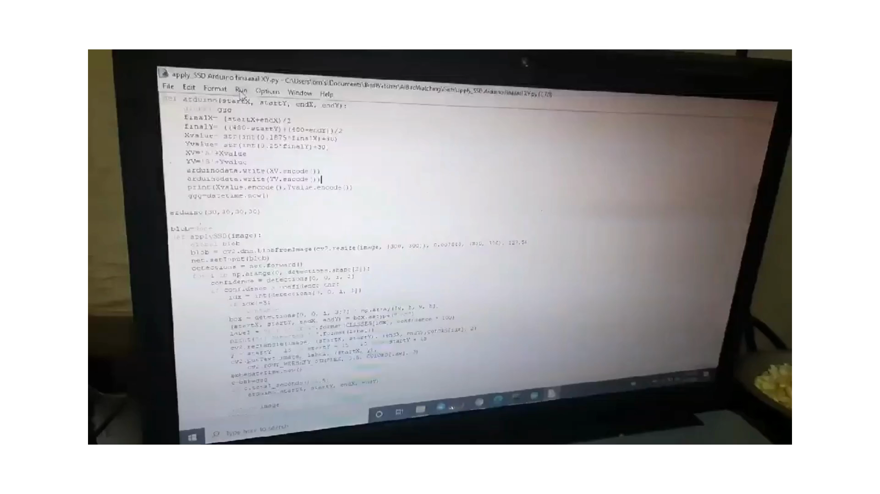

Slide 20
Scope of future work:
Object of the invention to provide engine guards that can be easily connected to existing aircraft engine wings.
This invention is directed to an aircraft engine guard, for protecting an aircraft engine against striking of birds, the guard comprising: a generally cone-shaped body; a base section at a rear end of the guard body.
It can also used at windmill area to avoid bird hitting with more accurate way.
We can use renewable energy sources like solar energy, wind energy, hydropower energy, etc.

Slide 21
THANK YOU

